Slide 1
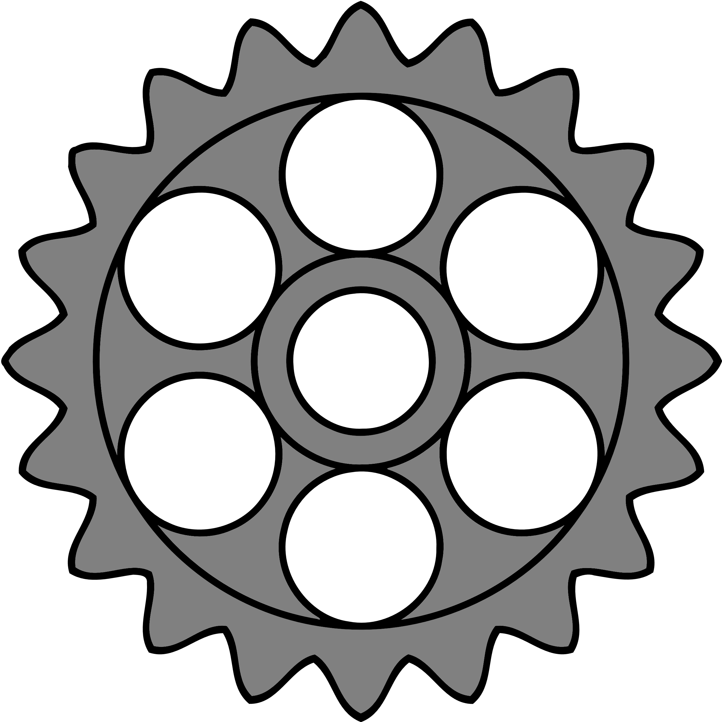

Version Control
“What one programmer can do in one month, two programmers can do in two months.”
– Fred Brooks
Notes:
1 min

Slide 2
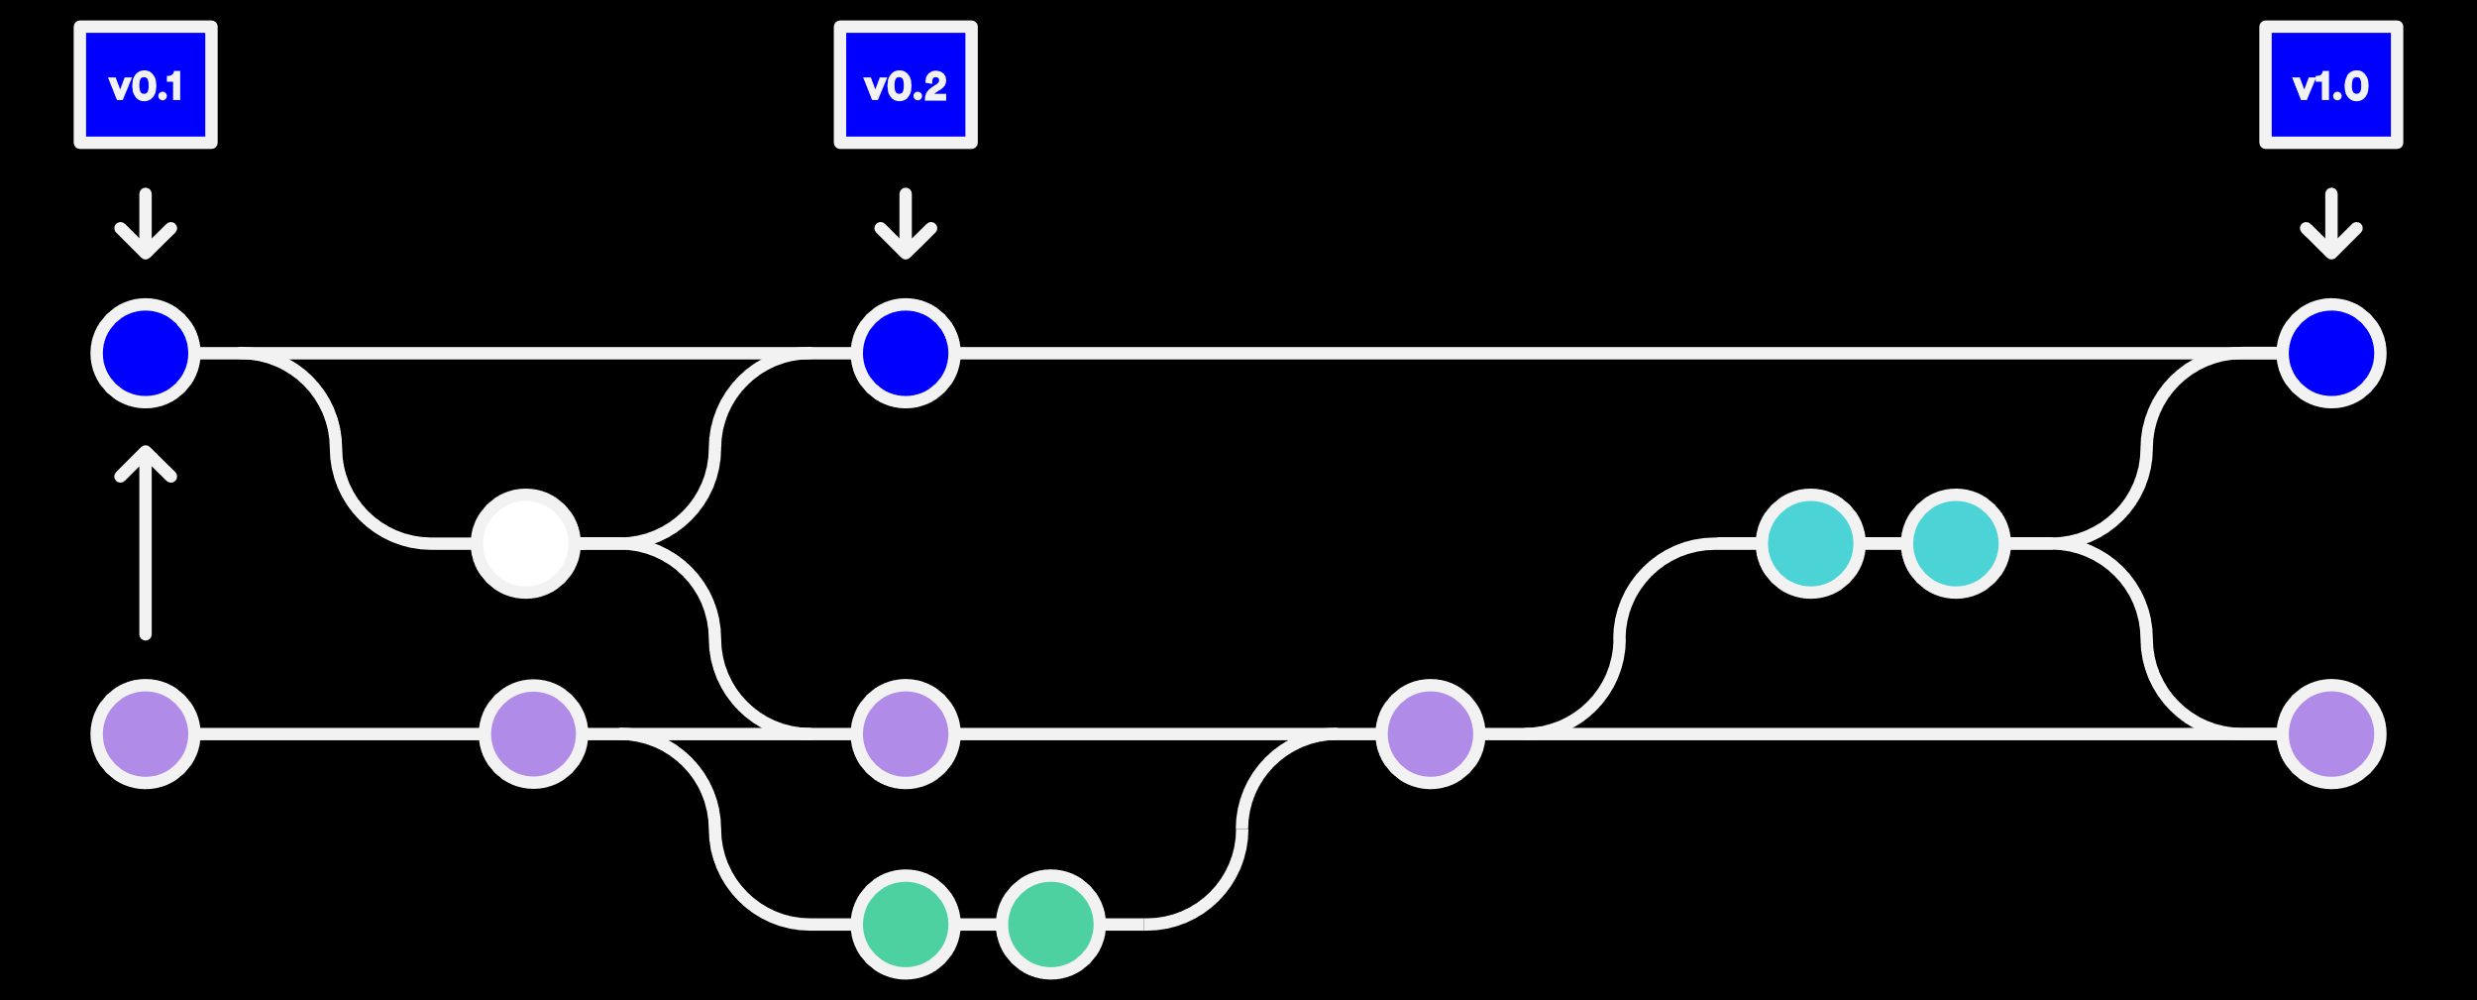
Version Control: Why?
Programmers are…
Awesome, and…
Brilliant, but…
Human, and…
Must work together.
We must plan to fail. Version control (revision control, source control) protects us from our own stupidity and faulty nature by storing changes!
Notes:
4.5 min

Slide 3
Version Control Basics
Version control…
Is based on commits
Can have branches
Supports merging
Usually supports tags
Tag
Commit
Stable
Bugfix
Backport
Branches
Development
Experimental
Merge
Notes:
9.5 min

Slide 4

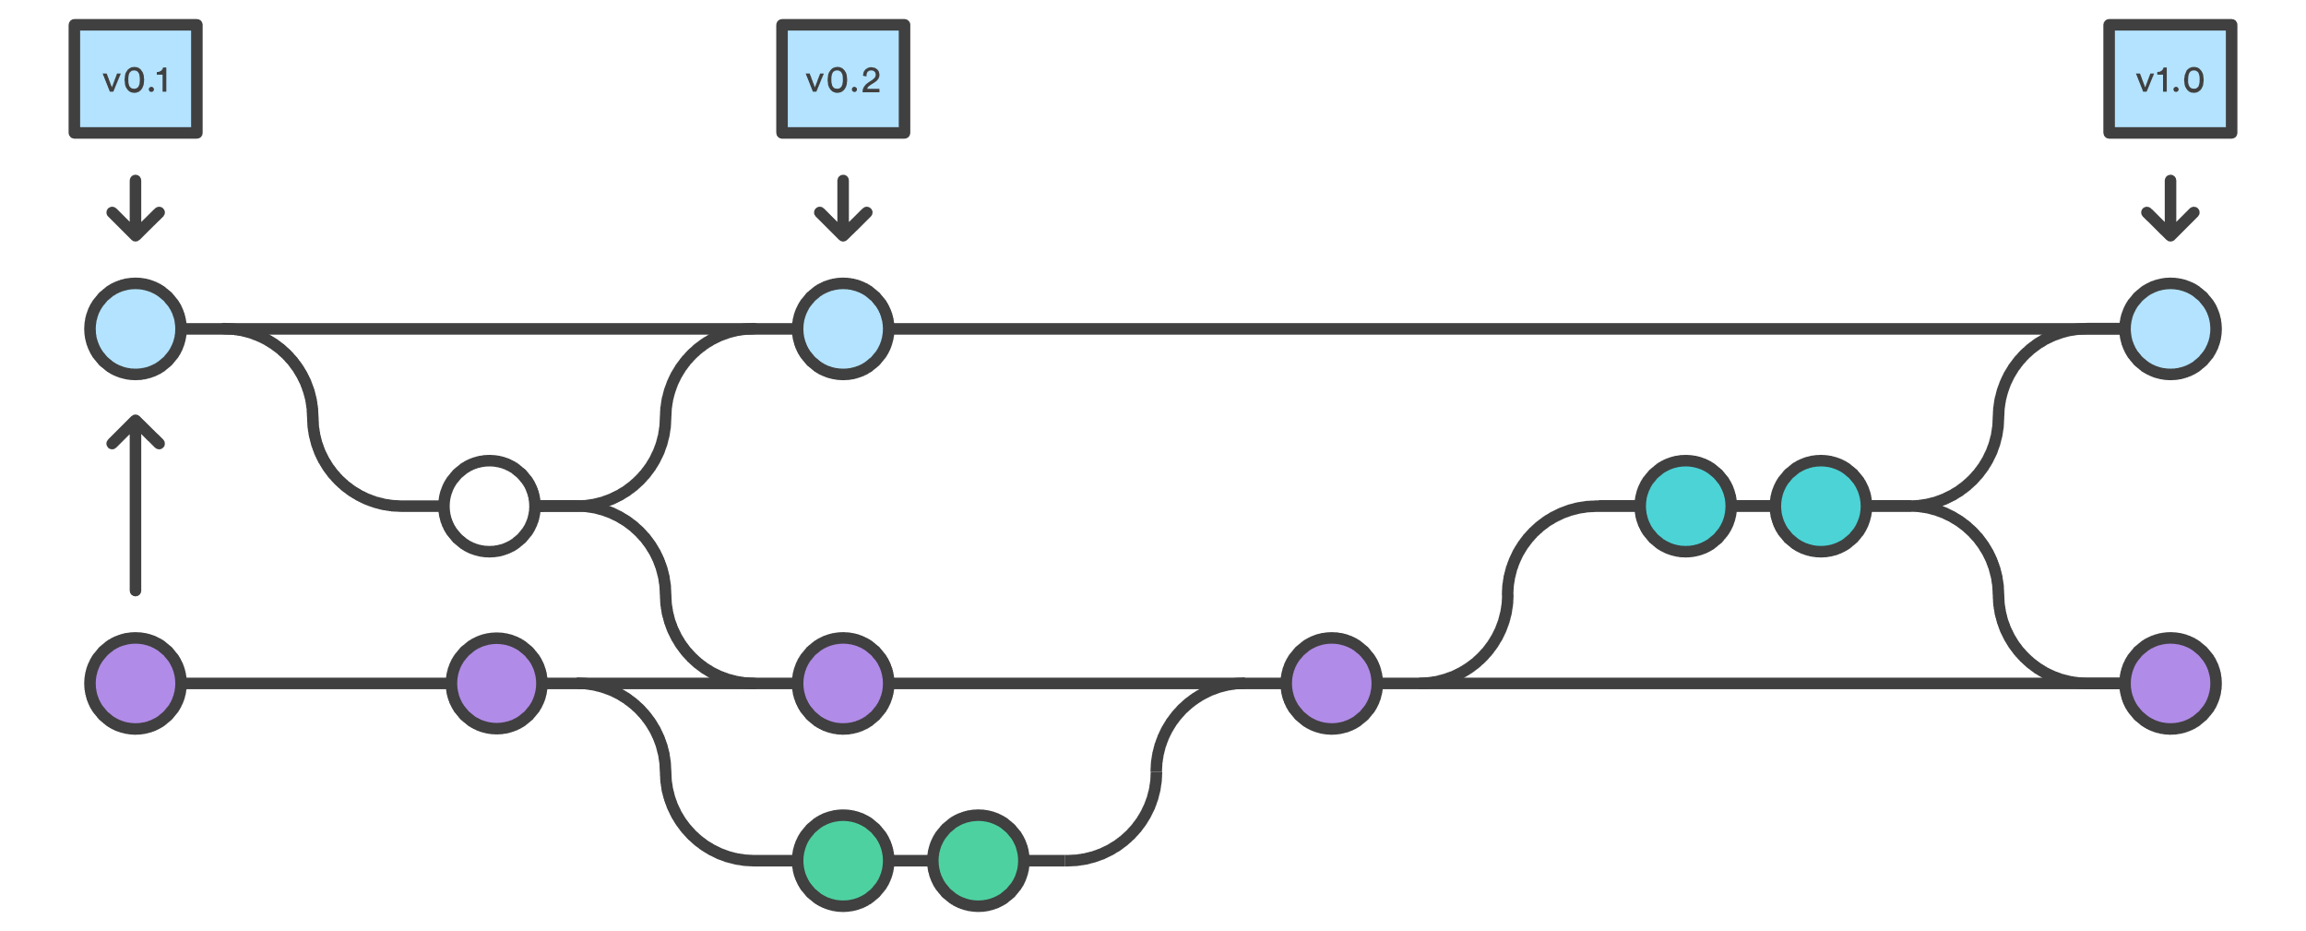
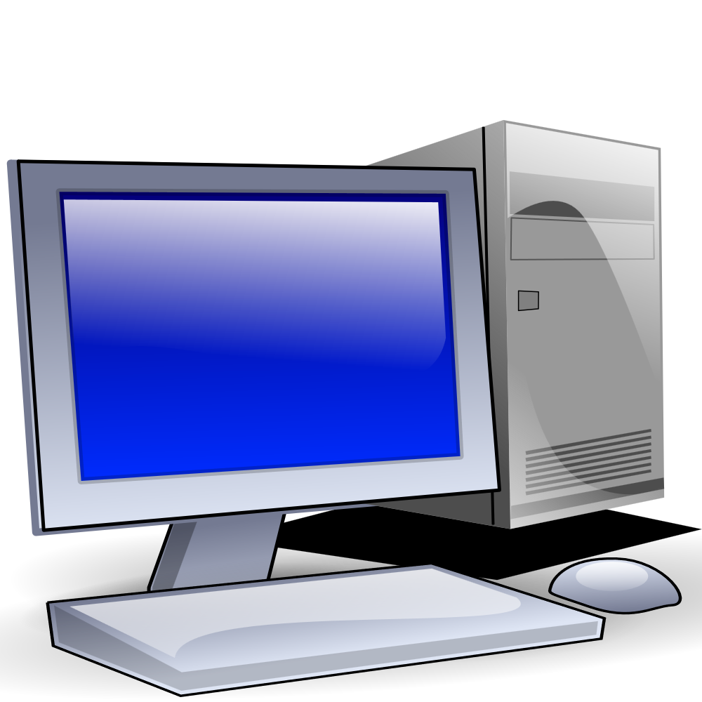
Git: Distributed Version Control
Git is a distributed version control system.
Everyone has a copy of the repository
May or may not have central repository
Commits are local until they are pushed
“Commit early and often” (low cost)
Notes:
7 min

Slide 5
Distributed VCS: Clone
A clone operation makes a copy of a repository locally.
Note: a clone does not capture any future commits!
Notes:
1.5 min

Slide 6
Distributed VCS: Commit
Performing a commit creates a changeset from one version to another.
New Commit
changes
Notes:
1 min

Slide 7
Distributed VCS: Push
A push operation pushes any changes up to a remote repository.
Notes:
1 min

Slide 8
Distributed VCS: Pull
A pull operation pulls down any changes made to the remote repository.
Notes:
1.5 min

Slide 9
And now for a demonstration…
There are many tools that can be used for Git repositories.
We will support the SourceTree GUI app on Windows and MacOS.
Recommendations for command line (you’ll need one of these):
Windows 11 – Windows Subsystem for Linux (i.e., Ubuntu on Windows)
MacOS – Type ‘git’ from a terminal.
Linux – Type ‘git’ from a terminal. Probably.
Notes:
3 min (demo?)

Slide 10

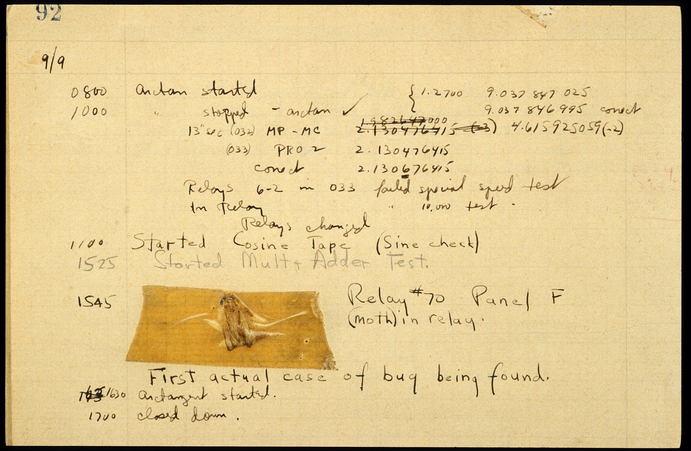
Debugging
Most of the time we spend “programming” is actually spent finding bugs.
Notes:
1 min

Slide 11

Debugging Strategies
When debugging, get as much information about program state as possible:
Exceptions
Assertions
Error Stream
Breakpoints
Log Files (Later)
Notes:
1.5 min

Slide 12
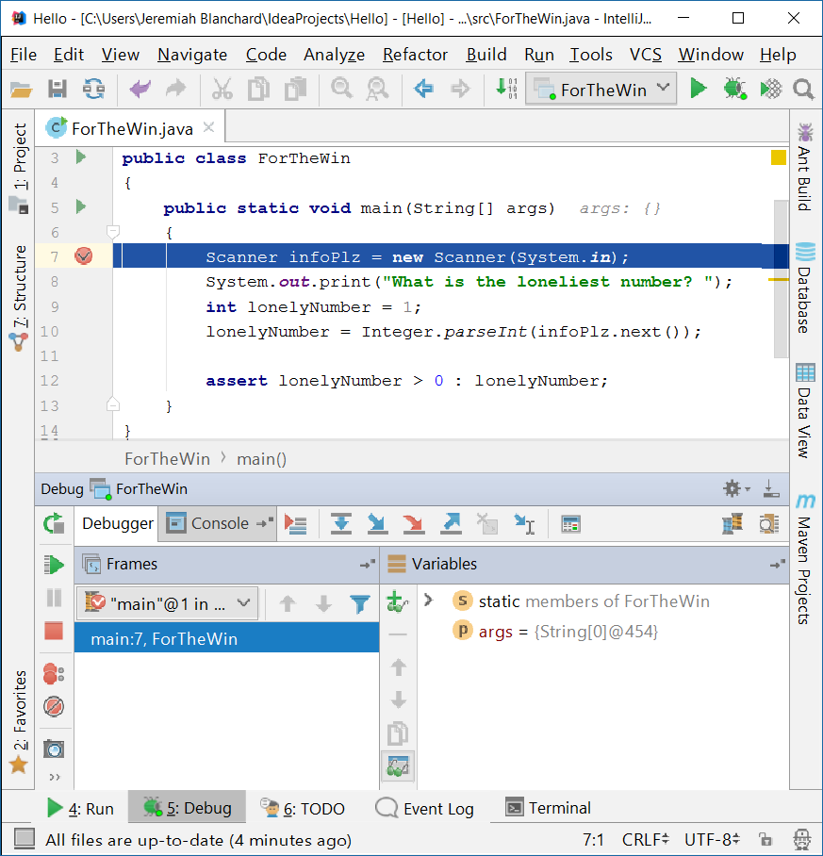
Debuggers
Most IDEs are integrated with a debugger which provides tools for debugging:
Breakpoints
Step-through
Stack trace
Variable watch
In most cases, you must run in the debug configuration (debug mode) to enable the debugger.
Notes:
2 min
Total: ~69 min

